Slide 1
Incremental Test Driven Development

Slide 2
Lets Play TDD #1 : The No Rambling Edit
Before start any work add or verify there is a stable environment
  @Test
  public void nothing() {
    fail(“hi”)
    }
  change the fail to pass
Create a test that crate an instance of SavingAccount and insert 100
  assertEqiuals the value is 100
Can add multiple test together
  ex deposit and withdrawl
Next Test : negavitveBalanceJustFind()

Slide 3
Peering Dimly into the Future
What is the purpose of the project
  focus on the viable project
  Create a savings account and age it a year
    Make it an immutable object
Concentrate on how it fits an understanding
Get it to work before you worry how you written it

Slide 4
Cleaning up my mess
Create a scratch pad where you can put the things you want to accomplish
Rename Test Classes and other classes to reflect better what is going on.
The Test Driven development can help decide what classes are need
Can refactor the test also
focus on taking smaller steps
Use @Ignore to put test aside
Questions to your peer : How will this be used in the prihect
Don’t make too many assumptions

Slide 5
Gaining on Capital Gains
Can remove functions when you get rid of the test
  Good for cleanup
Can have multiple test per functtion
  Withdraw More Than Prinicipal Incure Capital Gains Tax
Trying to figure out the idea hack and then clean up the code.

Slide 6
Title
https://www.codurance.com/katas/fizzbuzz

Slide 7
TDD – Write FizzBuzz
Write first test that fails.
Try to find the simplest test of functionality
  The program takes integers as input. The lowest positive integer is one
  Example
    class FizzBuzzShould {
    @Test
    void convert_1_to_1() {
    assertEquals("1", new FizzBuzz().convert(1));
    }
    }
    Fails to compile since the class does not exist
    Next create the class and function
You are not allowed to write any production code unless it is for making a failing unit test apss
Guiding principal of TDD is KISS – Write enough code to make the test pass
  Concentrating on the simplest solution possible an elegant solution will emerge
  Only introduce additional complexity as and when it is requured.

Slide 8
TDD – Write FizzBuzz
Many developers feel the urge to predict where the changes to the code should go -
  resist this urge.
  The beauty of TDD is that as you go along you will start to introduce the necessary features for the desired solution,
    but you will be guided by the tests, and the tests will confirm those changes once they are in place.
Second Cycle
  Our code has made the first step towards implementing this feature, but it's not correct yet: convert(2) will return "1".
  Example
    @Test
    void convert_2_to_2() {
    assertEquals("2", new FizzBuzz().convert(2));
    }
    Green Step
      public String convert(int number) {
      if (number == 2) return "2";
      return "1";
      }

Slide 9
TDD – Write FizzBuzz
Be patient – For the last functions convert (1), convert(2) we will clean up during refactor
  "the best decisions are made with the maximum possible information".
  pragmatic designers try to defer design decisions for as long as they can.
  By waiting for the duplication to happen three times, you allow the possibility of a larger more subtle pattern to emerge that requires a different design decision.
Don’t add more features until fully implemented
  choose another regular number, avoiding what we know will become Fizz
  Example
    @Test
    void convert_4_to_4() {
    assertEquals("4", new FizzBuzz().convert(4));
    }
    Simplest Solution is to add another statement
    public String convert(int number) {
    if (number == 4) return "4";
    if (number == 2) return "2";
    return "1";
    }

Slide 10
TDD – Write FizzBuzz
Be patient – For the last functions convert (1), convert(2) we will clean up during refactor
  "the best decisions are made with the maximum possible information".
  pragmatic designers try to defer design decisions for as long as they can.
  By waiting for the duplication to happen three times, you allow the possibility of a larger more subtle pattern to emerge that requires a different design decision.
Don’t add more features until fully implemented
  choose another regular number, avoiding what we know will become Fizz
  Example
    @Test
    void convert_4_to_4() {
    assertEquals("4", new FizzBuzz().convert(4));
    }
    Simplest Solution is to add another statement
    public String convert(int number) {
    if (number == 4) return "4";
    if (number == 2) return "2";
    return "1";
    }

Slide 11
TDD – Write FizzBuzz
    Refactor Phase
      In the above code we can spot the rule of three’
      Can replace the code with String.valueof
      For the test
        @ParameterizedTest
        @CsvSoruce
At this point, we have an algorithm that is incomplete in its implementationm, but covers the largest ( generic) use case
  Use Triangulation – Create a specific test case that forces the behavior of your code to change
Next less implement the fizz functionality
  Example
    @Test
    void convert_3_to_Fizz() {
    assertEquals("Fizz", new FizzBuzz().convert(3));
    }

Slide 12
TDD – Write FizzBuzz
Frequently asked questions
  Is this unnecessary complicated
    Be designing algorithms that are too big to reason about in one go.
    Write the simplest thing and build it up in baby steps.
    TDD scales very well
  What about invalid inputs
    Good design would suggest separating algorithm
    Could wrap FizzBuzz class by a FizzBuzzInputChecker Class
  Naming Test
    Name a test using implementation details
      don’t use class names since they change easily
      use the business functionality or feature
    Examples
      ClientLookupReturnsTrue
      SalesPriceDecoratorTest

Slide 13
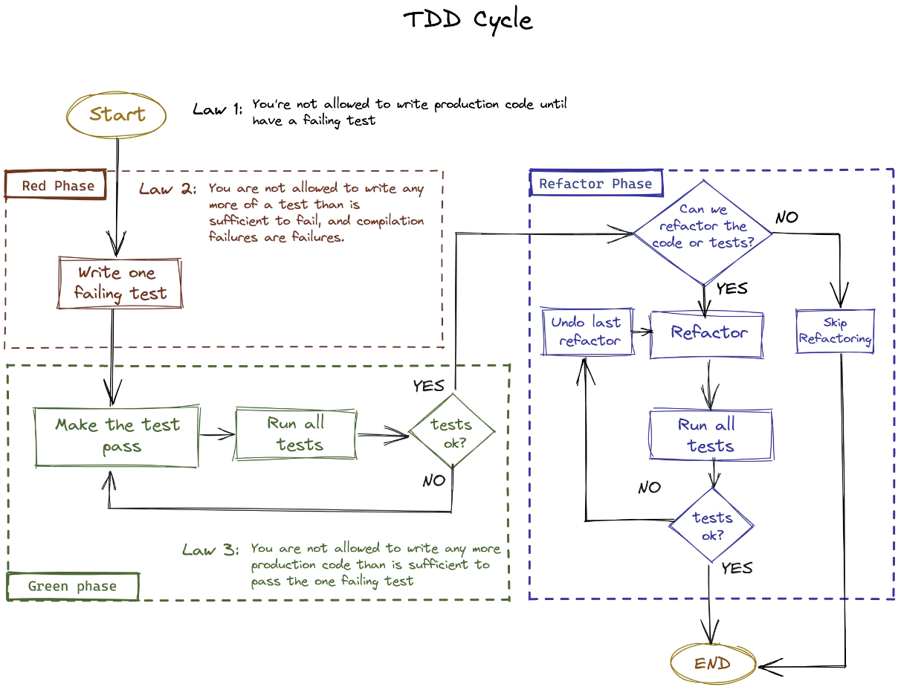
Algorithm

